Slide 1


Slide 2

African Al-Watikon Insurance Company
Company Profile
Integrated Insurance Solutions International Reinsurance Partnerships Specialized Technical Expertise
A corporate profile reflecting the company's identity and insurance services within the Libyan market.
2026

Slide 3

Company Overview:
Al-Watikon African Insurance Company is one of the ambitious companies operating within the Libyan insurance market. The company strives to provide comprehensive and effective insurance services that meet the needs of individuals and organizations while supporting the stability of economic activities through solutions designed for risk management and the protection of assets and liabilities.
The company is built upon modern professional foundations and relies on strong partnerships with international reinsurance companies, in addition to cooperation with a distinguished network of brokers in global markets, enhancing its ability to provide insurance coverage with high capacity and exceptional quality.
Al-Watikon African Insurance Company also relies on a specialized team possessing extensive expertise and competence across various insurance sectors, enabling the company to design flexible insurance programs that meet clients’ needs and help them face risks with confidence and stability, while maintaining long-term relationships built on trust and professionalism.
Exceptional Service for an Outstanding Experience...

Slide 4

Our Vision:
To become one of the leading providers of innovative insurance services in the Libyan market by developing insurance products that meet customer expectations and keep pace with the development of various economic sectors, while adhering to the highest standards of quality and efficiency.
Al-Watikon African Insurance – The Protection You Deserve

Slide 5

Our Mission:
We are committed to understanding our clients’ needs and delivering carefully tailored insurance solutions that provide protection and peace of mind, while ensuring prompt and transparent claims handling services through qualified technical professionals and a professional approach that reflects the company’s credibility.
Al-Watikon African Insurance – Your Partner in Security and Peace of Mind...

Slide 6

Our Core Values:
• Trust and transparency in dealing with clients and partners.
• Professionalism in underwriting, claims management, and customer service.
• Commitment to providing practical solutions tailored to the nature of each risk.
• Fast and flexible response to market needs.
• Building long-term relationships based on quality and sustainability.
Strong Values for Distinguished Service

Slide 7

Our Objectives:
• Support and strengthen the role of insurance in protecting the national economy.
• Deliver competitive insurance services based on quality and efficiency.
• Enhance insurance awareness within society.
• Develop comprehensive insurance products that meet diverse needs.
• Foster continuous innovation in insurance programs and solutions.
• Achieve sustainable growth and profitability that support the company's continuity.
Al-Watikon African Insurance – Building Trust Enhancing security..

Slide 8


Strengths & Competitive Advantages:
Flexible Insurance Solutions:
Products tailored to meet the needs of individuals, organizations, and various sectors.
.
International Reinsurance Partnerships:
Cooperation with international reinsurance markets and brokers, supporting high insurance capacities.
Specialized Technical Team:
Qualified professionals capable of assessing risks and designing insurance programs suitable for every type of activity.
Efficient Claims Management:
A methodology based on transparency and prompt follow-up of claims in accordance with technical and legal requirements.

Slide 9
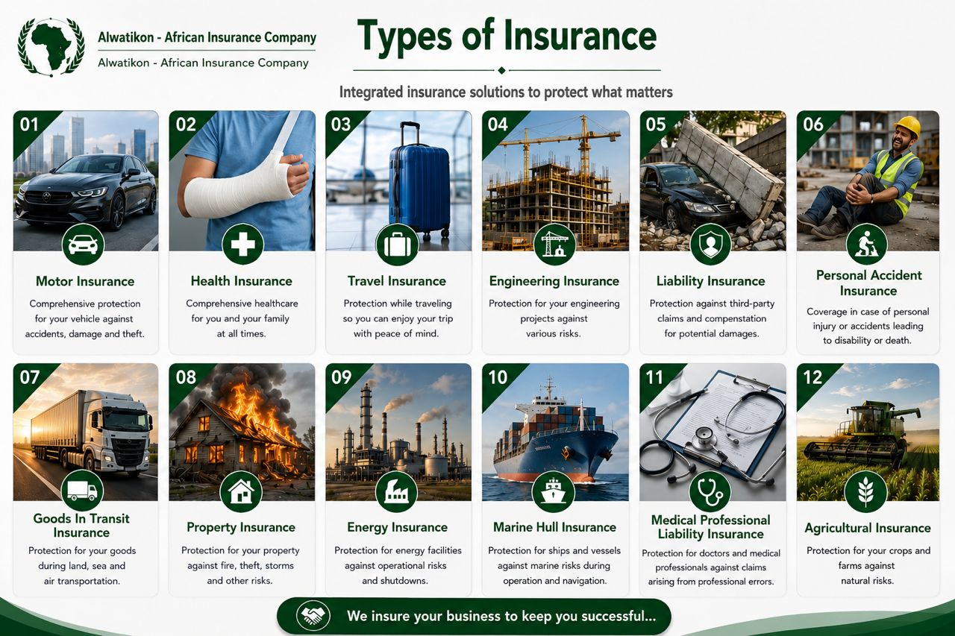

Slide 10

Our Approach to Working with Clients:
• Understanding the nature of the client's business and analyzing the associated risks.
• Identifying insurance requirements accurately according to the size of the risk and the nature of assets and liabilities.
• Designing suitable insurance proposals, including coverage, exclusions, and liability limits.
• Monitoring policy issuance and providing continuous technical and administrative support throughout the coverage period.
• Offering effective assistance in the event of claims to ensure prompt and transparent procedures.
Protecting Your Present and Securing Your Future...

Slide 11
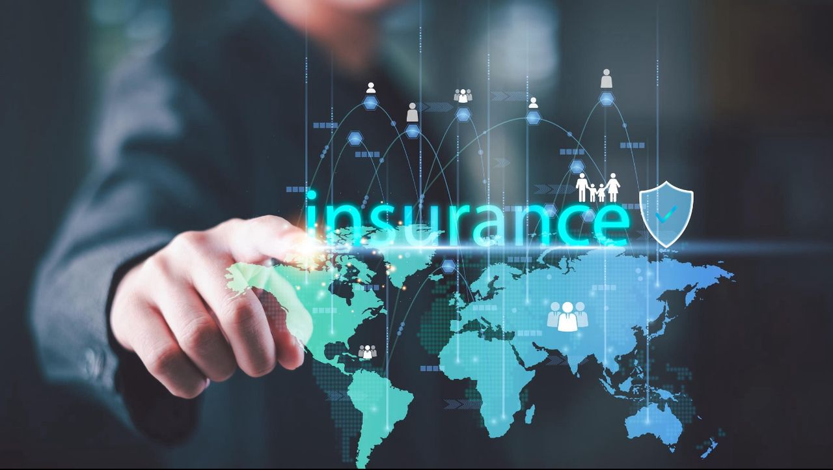
Why Al-Watikon African Insurance Company?
Because the company combines a modern vision, technical expertise, and the ability to develop practical insurance solutions tailored to the needs of the Libyan market.
Furthermore, its reliance on international reinsurance relationships and brokerage networks provides greater flexibility in handling large and specialized risks, while enhancing clients’ confidence in the quality of the coverage provided.
Your Security Begins with Us...

Slide 12

In conclusion:
Al-Watikon African Insurance Company is pleased to place its expertise and insurance services at the disposal of its clients and partners, reaffirming its readiness to provide suitable solutions that meet their needs and offer the highest levels of protection in accordance with best professional practices.
Al-Watikon African
Al-Watikon African Insurance – Confidence Leading Us Toward Success...

Slide 13

Al-Watikon African Insurance – Confidence That Protects You
Contact Us:
Head Office: Al-Nasr Street, Next to the Administrative Control Authority, Tripoli – Libya
phone:
0910930011 | 0913794131
Email: Alwatikon.Insurance@AF.ly

